Slide 1

DroTrack: High-speed Drone-based Object Tracking Under Uncertainty
Ali Hamdi, Flora Salim and Du Yong Kim
FUZZ-IEEE 2020

Slide 2
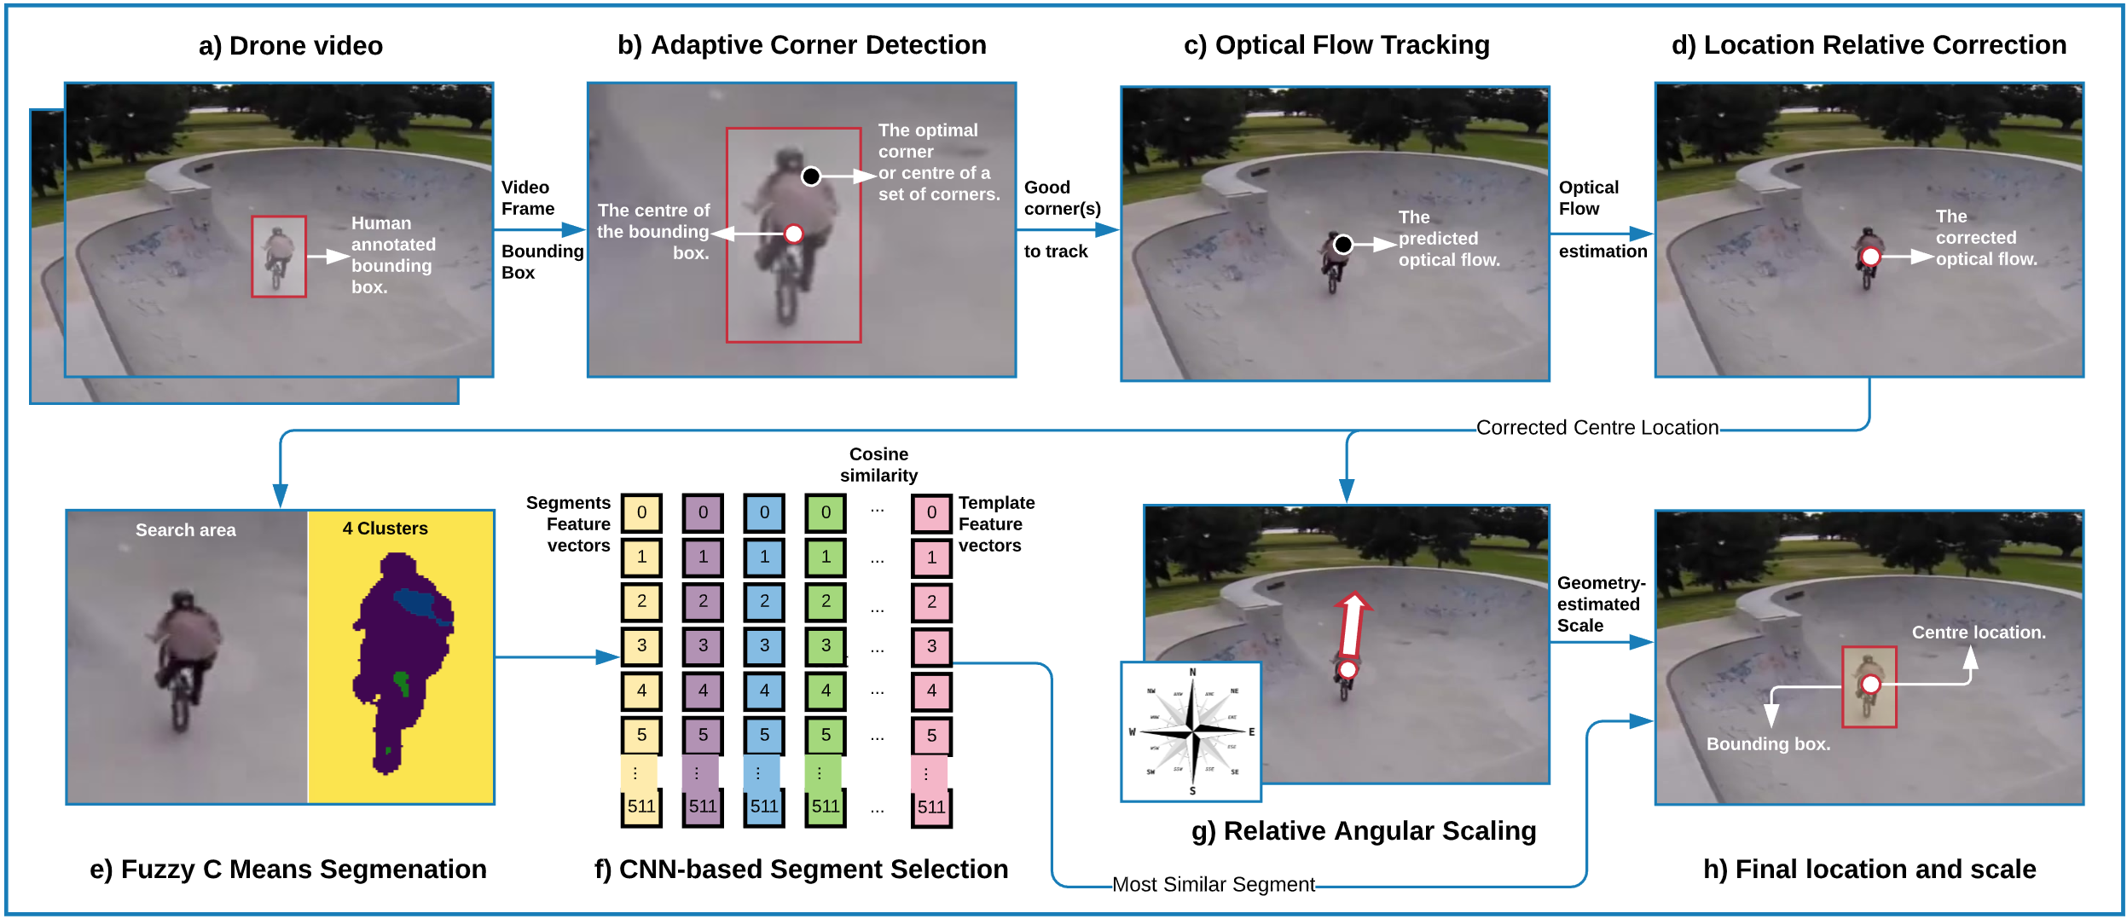
Drone-based Object Tracking
…

Slide 3
Research Problem
Inaccurate drone-based object tracking due to:
Complex and dynamic Situation uncertainty [1, 2, 3, 4]
High-speed dual motions changing in 360 degrees [5, 6, 7, 8].

Slide 4
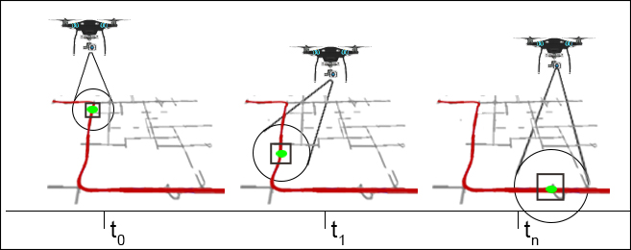
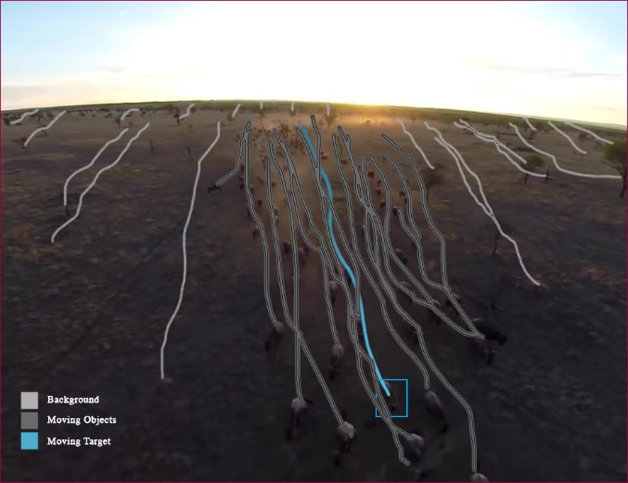
Research Problem
Challenges:
Noise
Occlusion
Cluttered background
Object varying features:
Position
Scale
Direction
Inverse motion
Out-view
High-speeding objects
Object locations and scales at three different timestamps
The impact of drone movement on the object optical flow tracking

Slide 5
Contributions
Adaptive feature extraction and optical flow methods that produce real-time single object tracking.
A spatial segmentation method that incorporates a Fuzzy C Means clustering with a CNN transfer learning model.
A heuristic geometrical method to estimate accurate object scales.
Comprehensive evaluation and benchmark with the baseline and state-of-the-art trackers using two drone-captured datasets with 51,462 frames.

Slide 6
Proposed Methodology: DroTrack High-speed Drone-based Object Tracking Under Uncertainty

Slide 7
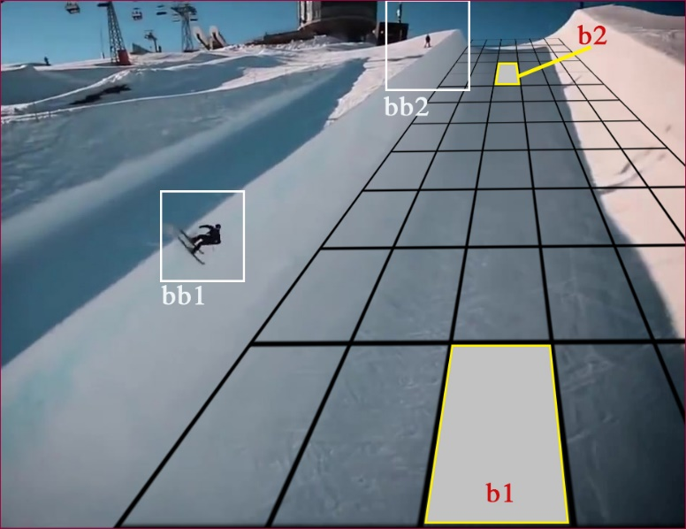
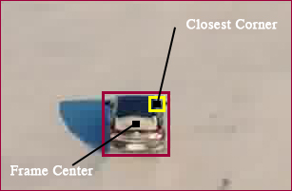
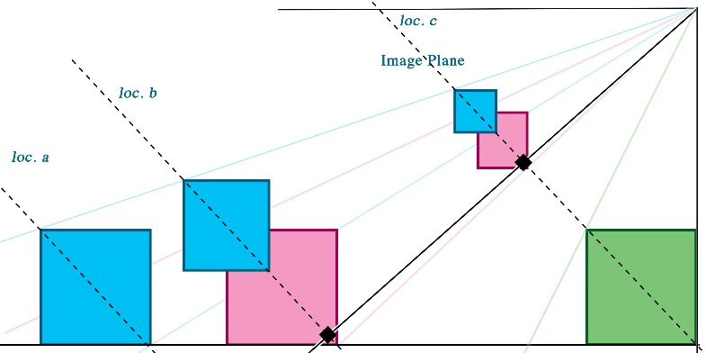
Optical Flow Correction & Relative Scaling

Slide 8
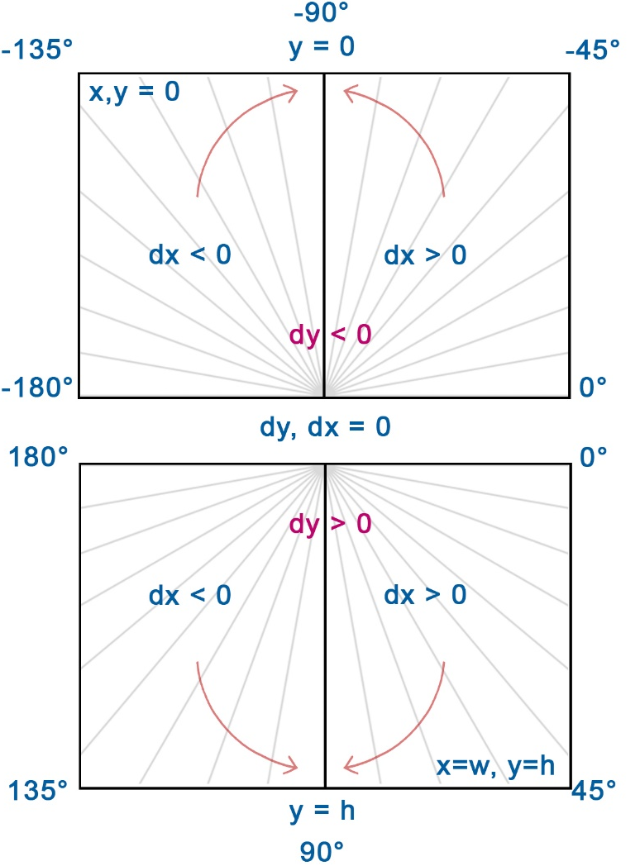
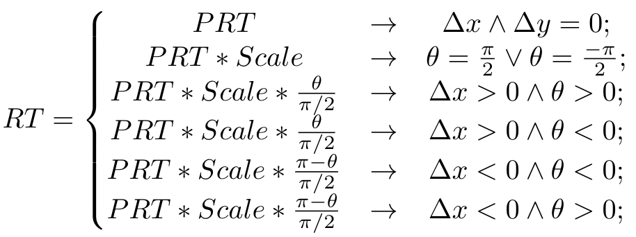
Relative Scaling

Slide 9
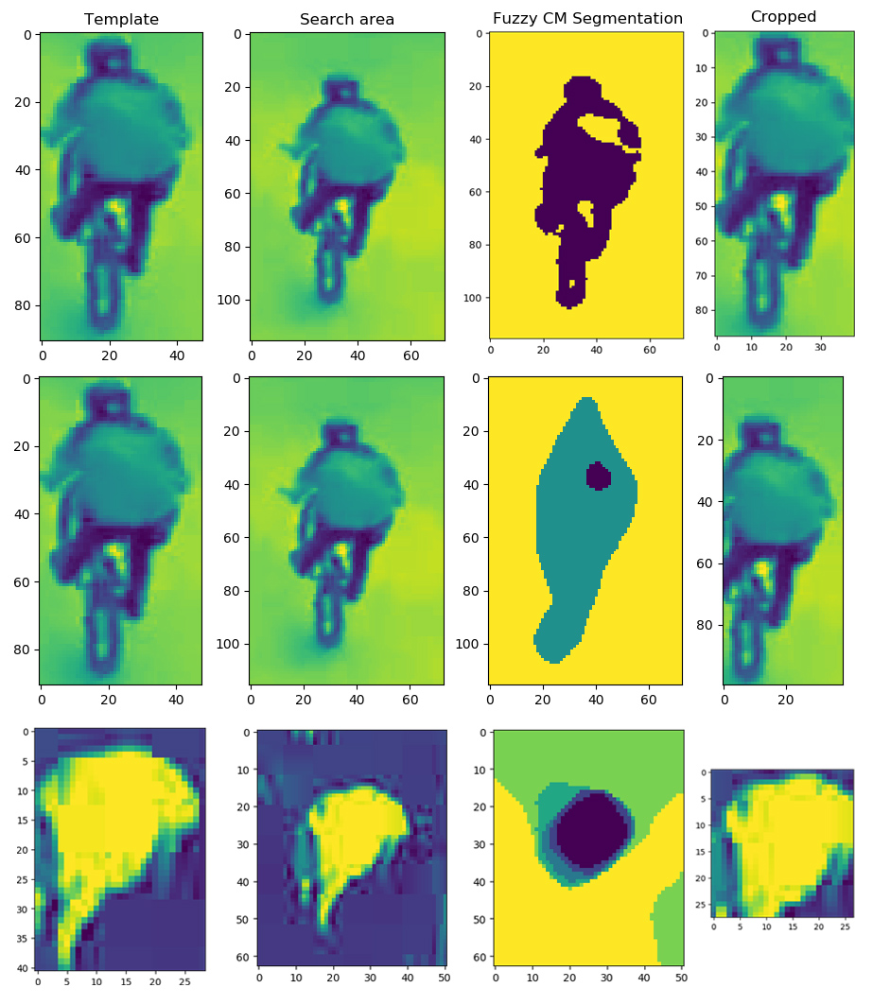
Fuzzy C-means Segmentation

Slide 10
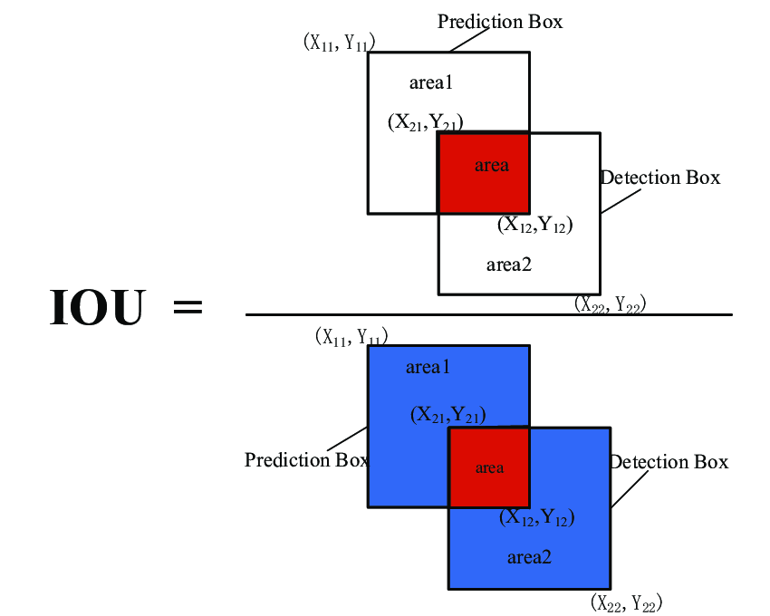
Benchmarking & Metrics
CSRT [Lukeziuaz et. al., 2018, IJCV]
ADNet [yun et. al., 2017, CVPR]
SiamFC [Bertinetto et. al., 2016, ECCV]
MIL [Babenko et. al., 2009, CVPR]
KCF [Henriques et. al., 2015, TPAMI]
Median Flow [Kalal et. al., 2010, ICPR]
Boosting [grabner et. al., 2006, Bmvc]
MOSSE [Bolme et. al., 2010, CVPR}
TLD [Kalal et. al., 2012, TPAMI]

Slide 11
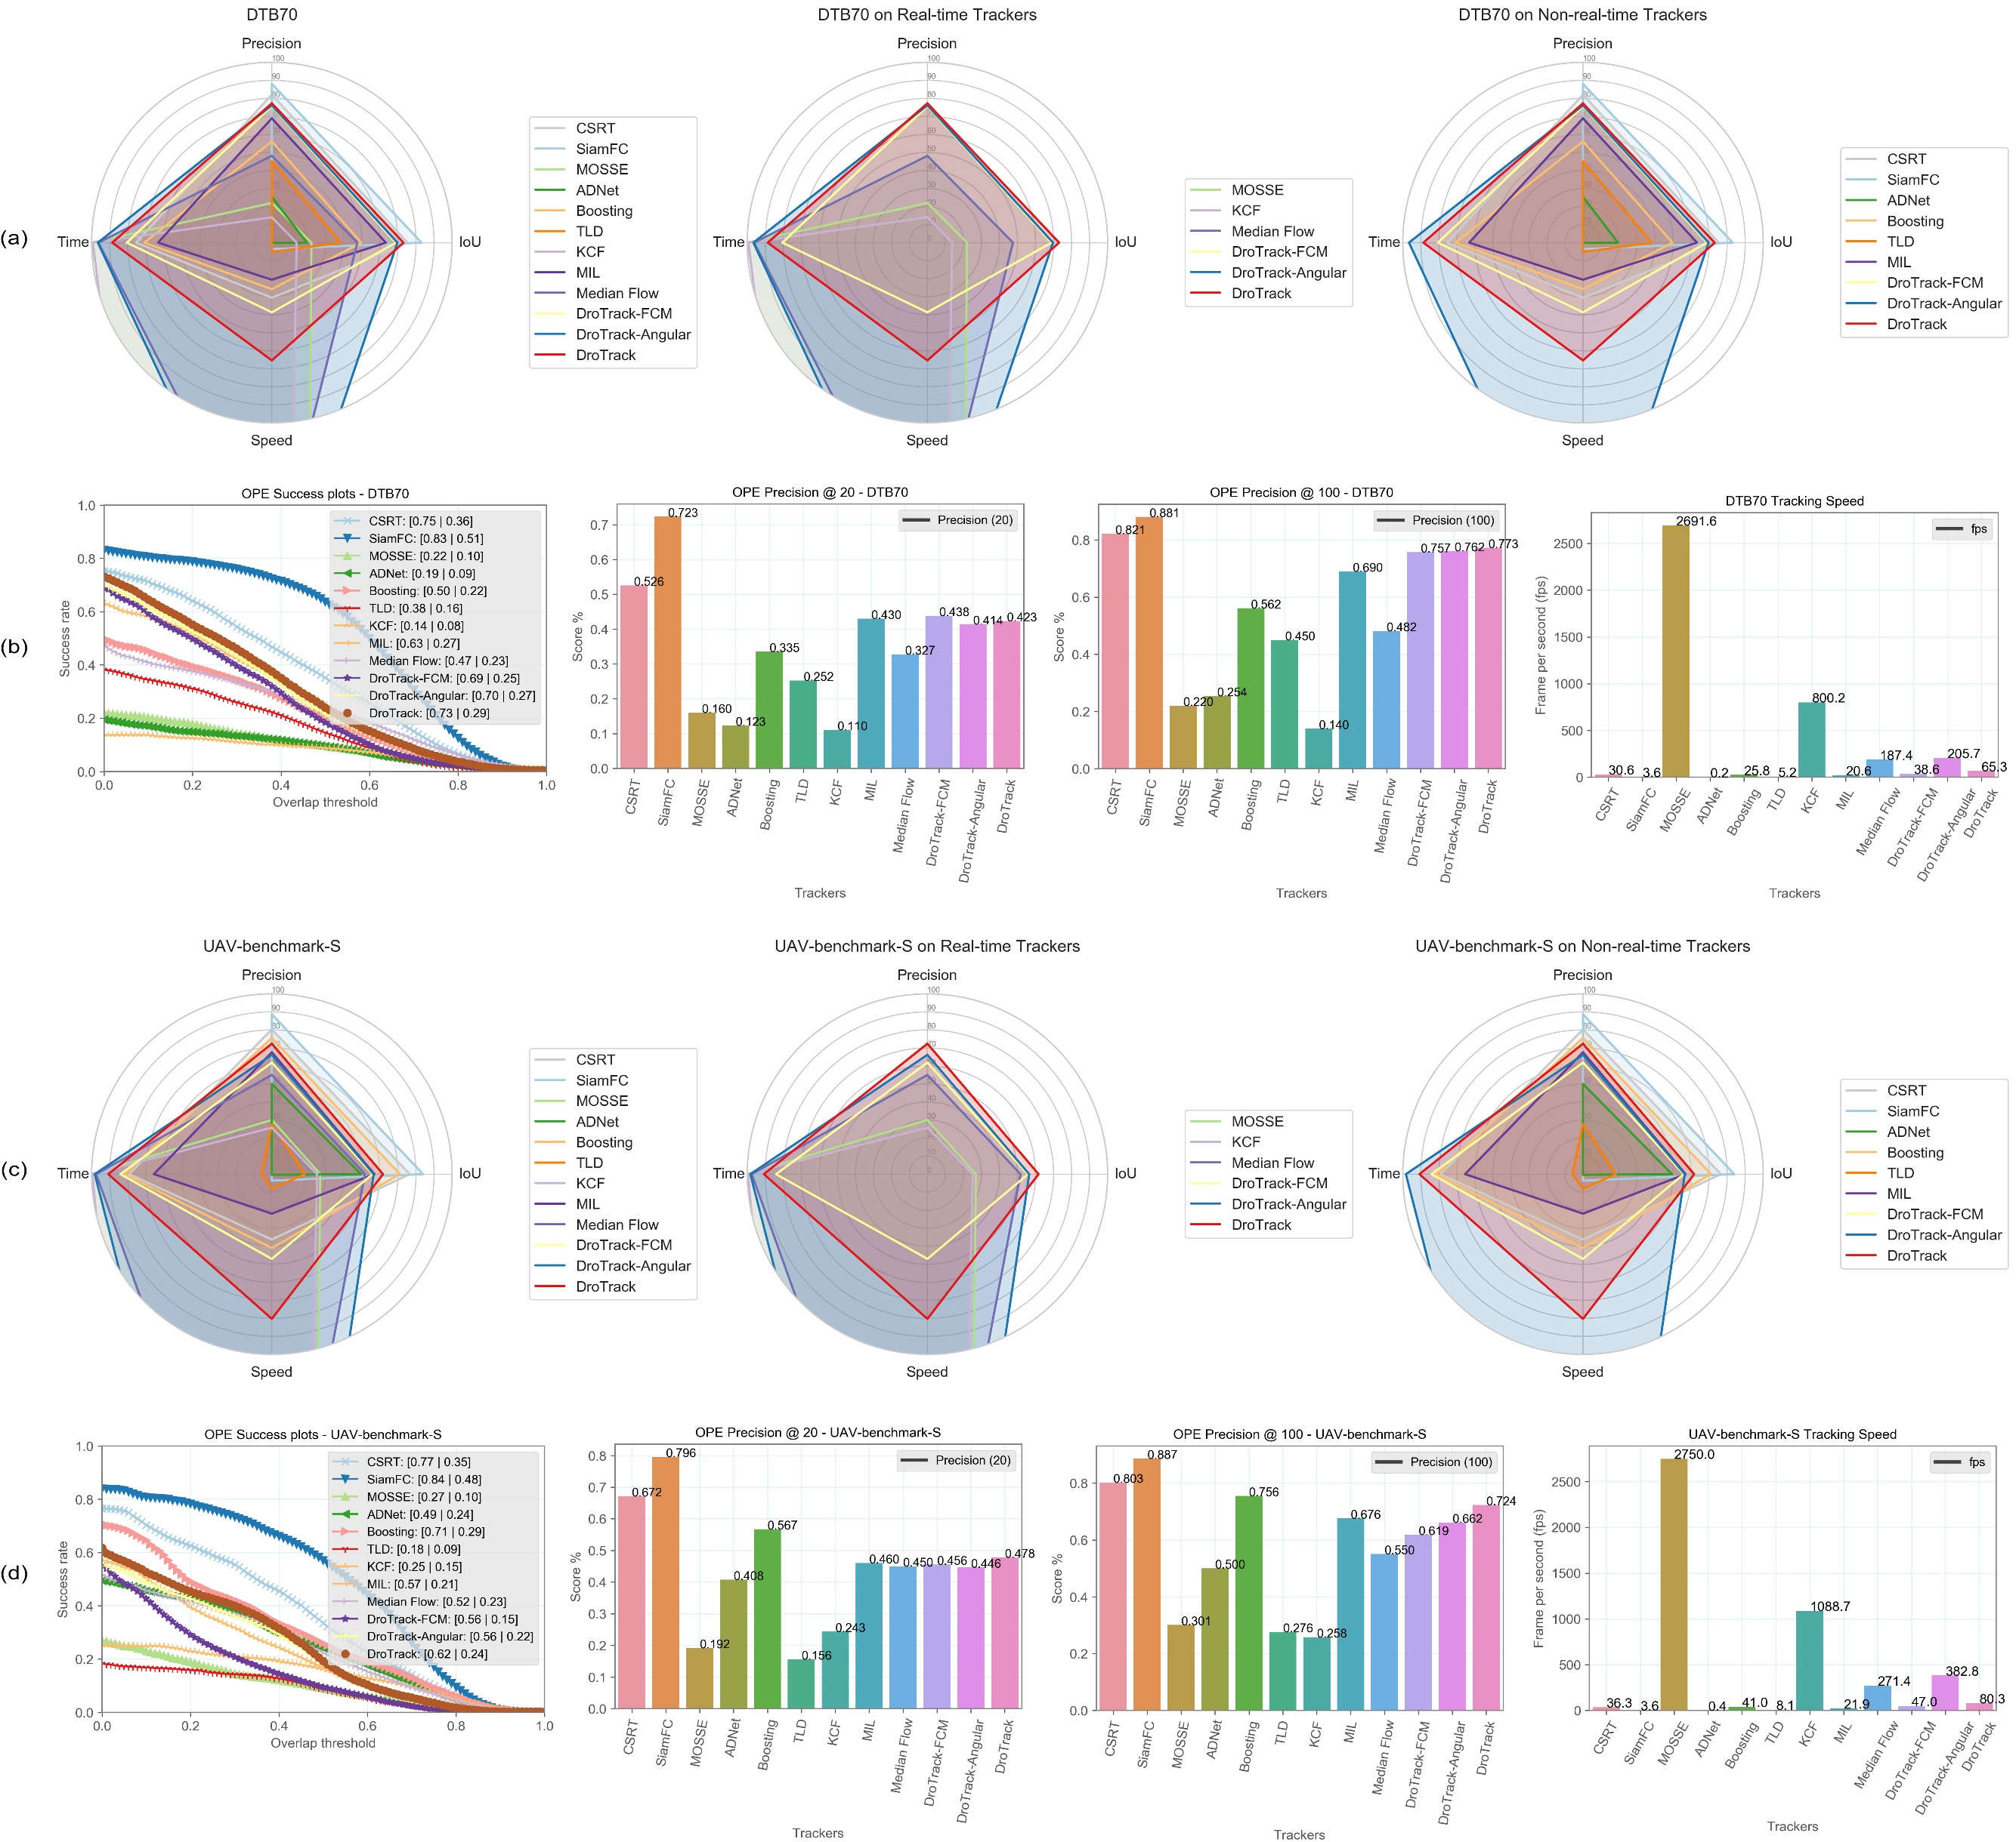
Results (DTB70)

Slide 12
Results (UAVDT-Benchmark-S)

Slide 13
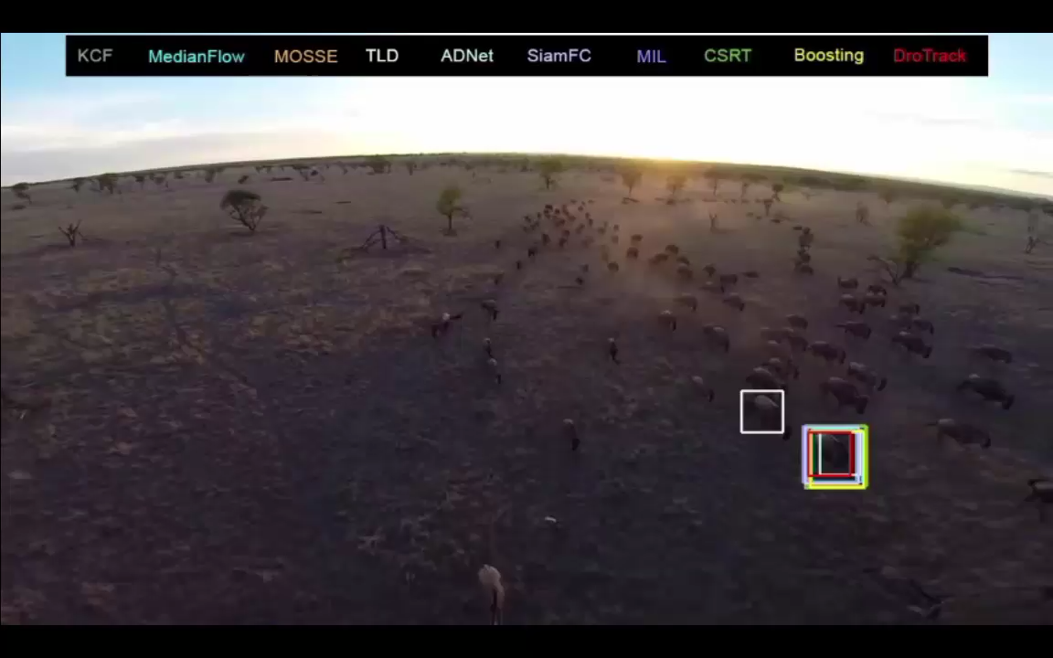

Slide 14
References
[1] S. Zhang, Y. Zhou, Z. Li, and W. Pan, “Grey wolf optimizerfor unmanned combat aerial vehicle path planning,”Advances in Engineering Software, vol. 99, pp. 121–136, 2016.
[2] C. YongBo, M. YueSong, Y. JianQiao, S. XiaoLong, and X. Nuo,“Three-dimensional unmanned aerial vehicle path planning usingmodified wolf pack search algorithm,”Neurocomputing, vol. 266,pp. 445–457, 2017.
[3] P. Kumar, S. Garg, A. Singh, S. Batra, N. Kumar, and I. You, “Mvo-based 2-d path planning scheme for providing quality of servicein uav environment,”IEEE Internet of Things Journal, vol. 5, no. 3,pp. 1698–1707, June 2018
[4] Y. S. Chang and H. J. Lee, “Optimal delivery routing with wider drone-delivery areas along a shorter truck-route,” Expert Systemswith Applications, vol. 104, pp. 307–317, 2018.
[5] L. Zhang, Z. Zhang, H. Xiong, Visual pedestrian tracking from a UAVplatform, in: 2017 2nd International Conference on Multimedia and Im-age Processing (ICMIP), IEEE, 2017, pp. 196–200.
[6] L. Jianfang, Z. Hao, G. Jingli, A novel fast target tracking method forUAV aerial image, Open Physics 15 (1) (2017) 420–426.
[7] L. N. Gaxiola, V. H. Diaz-Ramirez, J. J. Tapia, P. Garc ́ıa-Mart ́ınez, Targettracking with dynamically adaptive correlation, Optics Communications365 (2016) 140–149.
[8] . Zhang, H. Ge, J. Yang, Y. Yuan, A gm-phd algorithm for multiple tar-get tracking based on false alarm detection with irregular window, SignalProcessing 120 (2016) 537–552.

Slide 15
Code
https://github.com/cruiseresearchgroup/DroTrack
Ali Hamdi: ali.ali@rmit.edu.au
Acknowledgments
Ali Hamdi is supported by RMIT Research Stipend Scholarship. This research is also supported partially by the Australian Government through the Australian Research Council's Linkage Projects funding scheme (project LP150100246).

Slide 16
Thank You !

